Slide 1
Financial ratios
UNIT -6

Slide 2
Financial ratios are created with the use of numerical values taken from financial statements to gain meaningful information about a company. The numbers found on a company’s financial statements – balance sheet, income statement, and cash flow statement – are used to perform quantitative analysis and assess a company’s liquidity, leverage, growth, margins, profitability, rates of return, valuation, and more.

Slide 3
Financial ratios are grouped into the following categories:
Liquidity ratios
Leverage ratios
Efficiency ratios
Profitability ratios
Market value ratios

Slide 4
Uses and Users of Financial Ratio Analysis
Analysis of financial ratios serves two main purposes:
1. Track company performance
Determining individual financial ratios per period and tracking the change in their values over time is done to spot trends that may be developing in a company. For example, an increasing debt-to-asset ratio may indicate that a company is overburdened with debt and may eventually be facing default risk.
2. Make comparative judgments regarding company performance
Comparing financial ratios with that of major competitors is done to identify whether a company is performing better or worse than the industry average. For example, comparing the return on assets between companies helps an analyst or investor to determine which company is making the most efficient use of its assets.
Users of financial ratios include parties external and internal to the company:
External users: Financial analysts, retail investors, creditors, competitors, tax authorities, regulatory authorities, and industry observers
Internal users: Management team, employees, and owners

Slide 5
Liquidity Ratios -Liquidity ratios are financial ratios that measure a company’s ability to repay both short- and long-term obligations. Common liquidity ratios include the following:
The current ratio measures a company’s ability to pay off short-term liabilities with current assets:
Current ratio = Current assets / Current liabilities
The acid-test ratio ( Quick Ratio)measures a company’s ability to pay off short-term liabilities with quick assets:
Acid-test ratio = Current assets – Inventories / Current liabilities

Slide 6
The cash ratio measures a company’s ability to pay off short-term liabilities with cash and cash equivalents:
Cash ratio = Cash and Cash equivalents / Current Liabilities
The operating cash flow ratio is a measure of the number of times a company can pay off current liabilities with the cash generated in a given period:
Operating cash flow ratio = Operating cash flow / Current liabilities

Slide 7
Leverage Financial Ratios
Leverage ratios measure the amount of capital that comes from debt. In other words, leverage financial ratios are used to evaluate a company’s debt levels. Common leverage ratios include the following:

Slide 8
The debt ratio measures the relative amount of a company’s assets that are provided from debt:
Debt ratio = Total liabilities / Total assets = total liabilities / toatl liabilties + total equity
The debt to equity ratio calculates the weight of total debt and financial liabilities against shareholders’ equity:
Debt to equity ratio = Total liabilities (long-term debt)/ Shareholder’s equity(funds)
The interest coverage ratio shows how easily a company can pay its interest expenses:
Interest coverage ratio = Operating income(profit before interest) / Interest expenses
The debt service coverage ratio reveals how easily a company can pay its debt obligations:
Debt service coverage ratio = Operating income (profit before interest) / Total debt service(fixed interest charges)

Slide 9
Efficiency Ratios
Efficiency ratios, also known as activity financial ratios, are used to measure how well a company is utilizing its assets and resources. Common efficiency ratios include:

Slide 10
The asset turnover ratio measures a company’s ability to generate sales from assets:
Asset turnover ratio = Net sales / average Total assets
The inventory turnover ratio measures how many times a company’s inventory is sold and replaced over a given period:
Inventory turnover ratio = Cost of goods sold / Average inventory
Where average inventory = opening stock + Closing stock / 2
Fixed asset turnover = Cost of goods sold / fixed assets
Average collection period = total receivable / net credit sales *no. of working days
Account receivable turnover ratio =

Slide 11
Profitability Ratios
Profitability ratios measure a company’s ability to generate income relative to revenue, balance sheet assets, operating costs, and equity. Common profitability financial ratios include the following:

Slide 12
The gross margin ratio compares the gross profit of a company to its net sales to show how much profit a company makes after paying its cost of goods sold:
Gross margin ratio = Gross profit / Net sales
The operating margin ratio compares the operating income of a company to its net sales to determine operating efficiency:
Operating margin ratio = Operating income / Net sales = Cost of googs sold + operating expenses / net sales
Where cost of goods sold = sales -gross profit
The return on assets ratio measures how efficiently a company is using its assets to generate profit:
Return on assets ratio = Net income / Total assets
The return on equity ratio measures how efficiently a company is using its equity to generate profit:
Return on equity ratio = Net income / Shareholder’s equity
Net profit ratio = net profit after tax / net sales *100
Propertiory ratio = propertiory fund / total asset

Slide 13
Market Value Ratios
Market value ratios are used to evaluate the share price of a company’s stock. Common market value ratios include the following:

Slide 14
The book value per share ratio calculates the per-share value of a company based on equity available to shareholders:
Book value per share ratio = Shareholder’s equity / Total shares outstanding
The dividend yield ratio measures the amount of dividends attributed to shareholders relative to the market value per share:
Dividend yield ratio = Dividend per share / Share price
The earnings per share ratio measures the amount of net income earned for each share outstanding:
Earnings per share ratio = Net earnings / Total shares outstanding
The price-earnings ratio compares a company’s share price to its earnings per share:
Price-earnings ratio = Share price / Earnings per share

Slide 15
Q. From the following data, calculate liquid ratio:
Current Assets – 20,000
Stock – 3,000
Prepaid Expenses – 1,000
Working capital – 16,800

Slide 16
Liquid ratio ( quick ratio ) = Quick assets / current liabilities
Quick assets= Current assets – ( stock+ prepaid exp)
= 20,000- (3000+1000)= 16,000
Current liabilities = Current assets- working capital = 20000-16800 = 3200
Liquid ratio = 16000/3200 = 5

Slide 17
Q.2 Total assets Rs1,10,000 ,Fixed assets Rs 50000, Capital employed Rs 90,000.Calculate current ratio.
Current ratio = Current assets / current liabilities
We know current assets = Total assets – fixed assets = 110000-50000 = 60000
Current liabilities = Total assets – capital =
1,10000- 90000= 20000
Current ratio = 60000/20000= 3

Slide 18
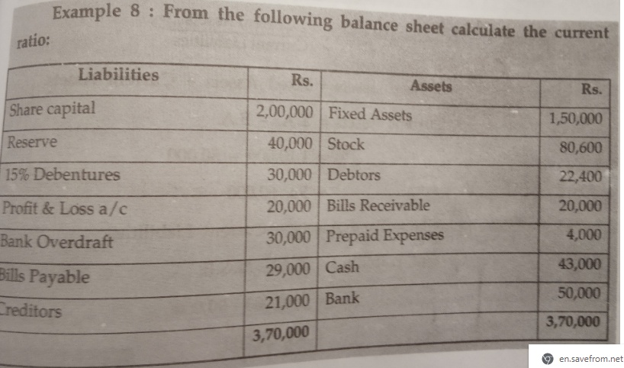

Slide 19
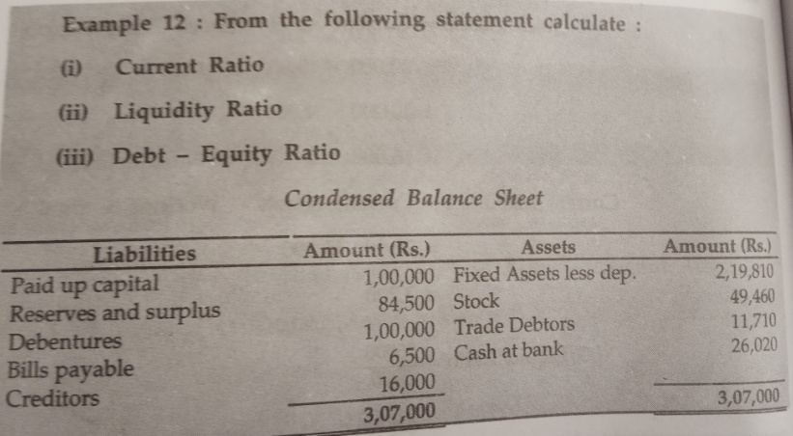

Slide 20
Curent asset =49460+11710+26020= 87190
Current liabilities = 6,500 + 16000 = 22500
(a)Current ratio = 87190/22500= 3.88/1
Quick asset = current asset – stock = 87190-49460= 37730
(b) Quick ratio = 37730/22500= 1.68:1
(c) Debt- Equity ratio = total debt / shareholder fund

Slide 21
Total debt = debenture + cuurent liabilities =
100000+22500= 122500
Shareholder fund = 100000+84500= 184500
Debt- Equity ratio = 122500/184500= .66/1

Slide 22
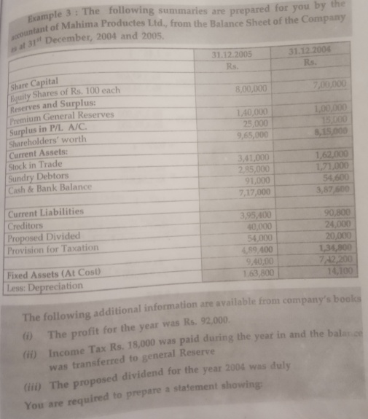

Slide 23
find
1.Current ratio
Liquidity ratio
return on proprietor’s funds

Slide 24
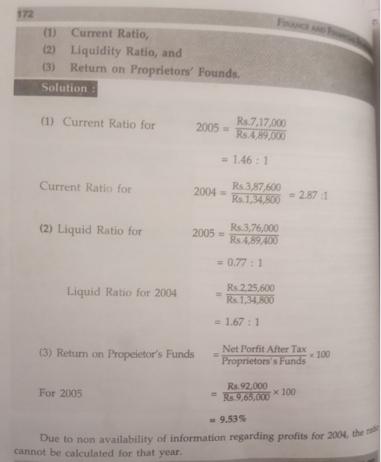

Slide 25
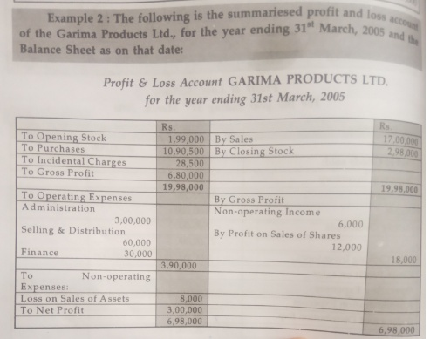

Slide 26
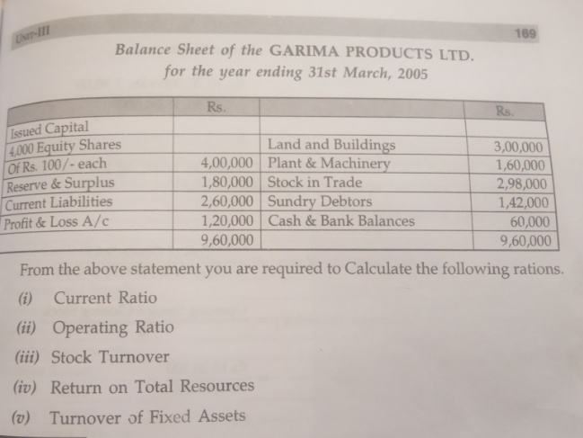

Slide 27
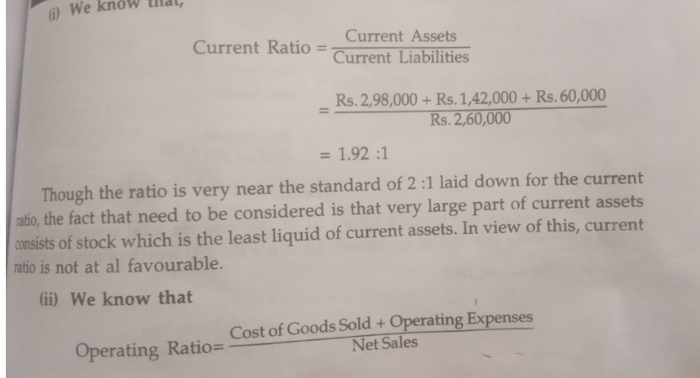

Slide 28
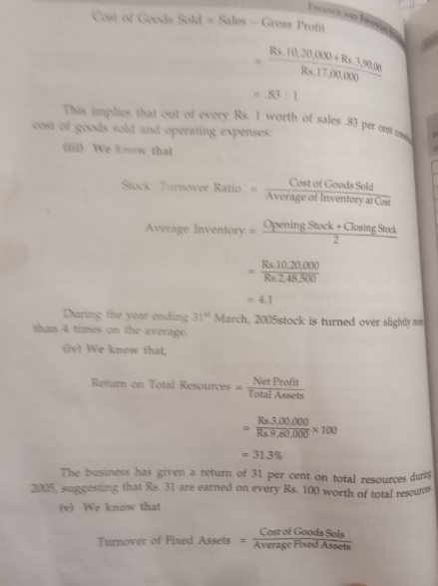

Slide 29
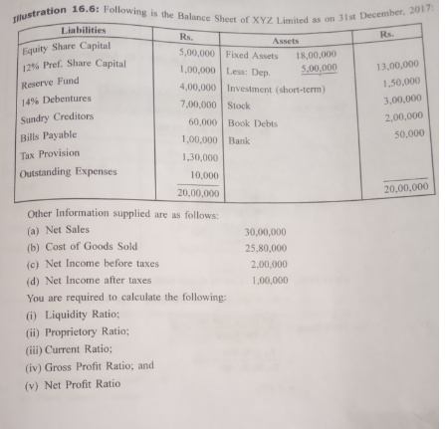

Slide 30
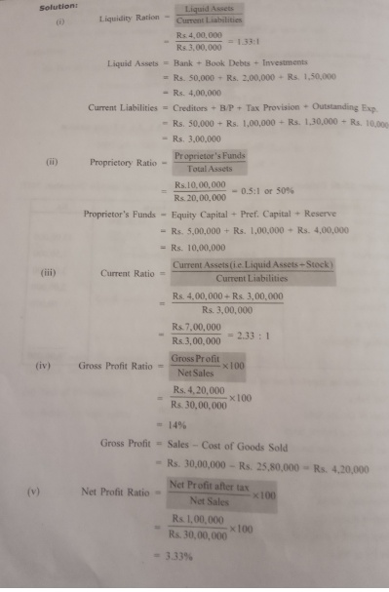

Slide 31
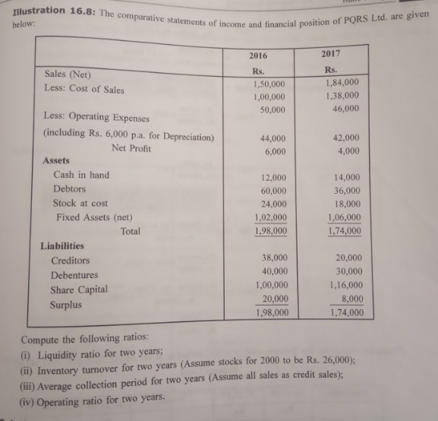

Slide 32
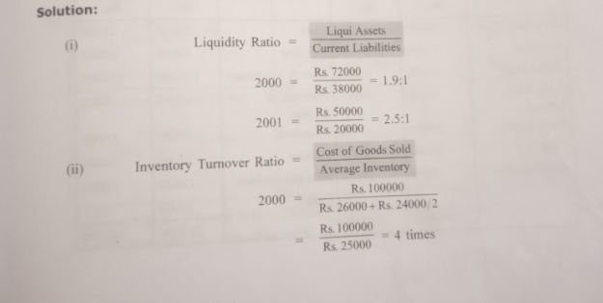

Slide 33
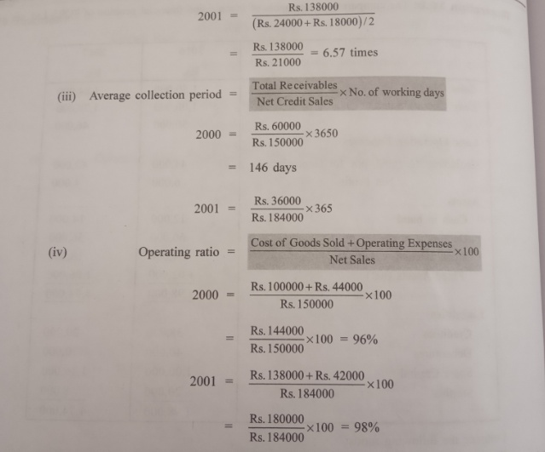

Slide 34
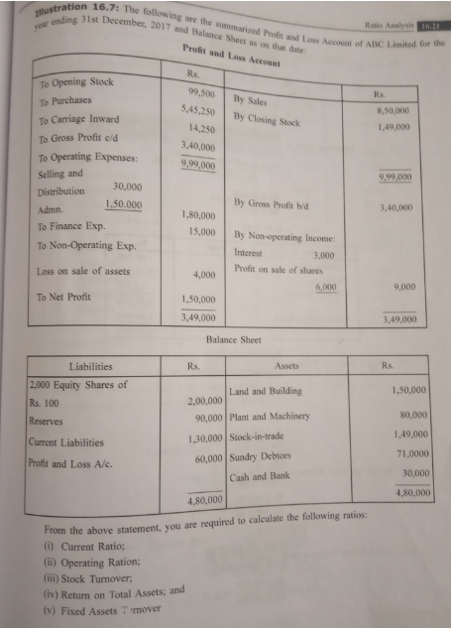

Slide 35
